Slide 1
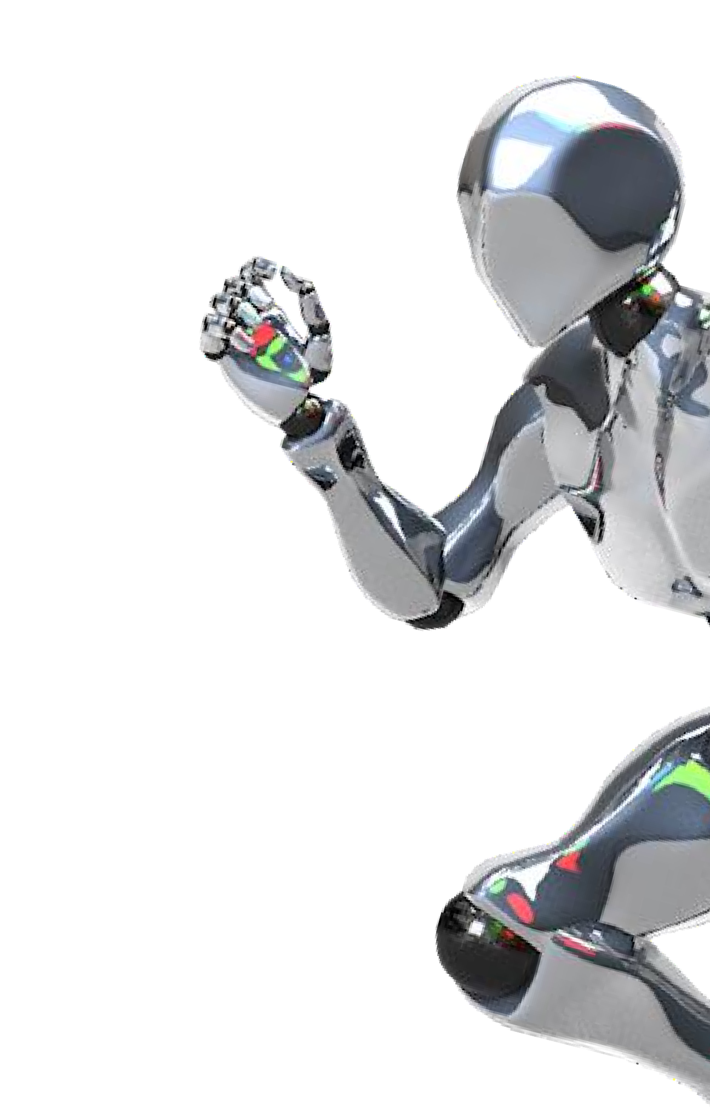
ELECTRICITY
CONSUMPTION FORECASTING
Presentation By: Sagar
12201185

Slide 2

INTRODUCTION
Electricity consumption forecasting is essential for managing energy usage efficiently and avoiding unnecessary power wastage. This project aims to build a simple and effective machine learning model that can predict electricity consumption based on important input factors like temperature, humidity, and appliance usage.
Using a Linear Regression model, the system analyzes these parameters to generate accurate consumption estimates. The model is integrated into a Streamlit web app, allowing users to enter values and instantly view predictions. This project highlights how machine learning can support smarter and more efficient energy decisions.

Slide 3

PROBLEM STATEMENT
Electricity consumption is influenced by several environmental and usage factors.
Users often lack a simple way to estimate their electricity usage based on conditions like temperature, humidity, and appliance load.
Without prediction, it becomes difficult to plan energy usage and identify potential overconsumption.
There is a need for a machine learning model that can provide quick and reliable electricity consumption forecasts.

Slide 4


To develop a machine learning model that can accurately predict electricity consumption.
To analyze how Temperatu0re4, Humidity, and Appliance Usage affect overall electricity usage.
To create a preprocessing and training pipeline using Linear Regression for prediction.
To evaluate model performance using metrics such as MSE and R² score.
To build a user-friendly Streamlit web application for real-time electricity consumption prediction.
To provide an efficient tool that helps users plan and monitor energy usage effectively.

Slide 5

DATASET
DESCRIPTION
The dataset contains four numerical features: Temperature, Humidity, Appliance Usage, and the target variable Electricity Consumption.
05
Each row represents a single observation of environmental factors and corresponding electricity consumption value.
Electricity consumption is influenced by a combination of these variables, showing how external conditions and appliance usage impact energy usage.
The dataset is synthetic but realistic, designed using statistical distributions to simulate real- world power consumption behavior.

Slide 6

METHODOLOGY / WORKFLOW
01 Data Preparation
Loaded the dataset containing Temperature, Humidity, Appliance Usage, and Electricity Consumption. Performed basic inspection and visualization to understand distribution patterns.
02
Preprocessing
Applied StandardScaler using a ColumnTransformer to normalize all numerical input features for better model performance.
03 Model Training
Split the dataset into training and testing sets (80/20 ratio). Built a Linear Regression pipeline combining preprocessing and model training in a single flow.
04
Model Evaluation & Saving
Evaluated performance using MSE and R² score. Saved the final trained pipeline using joblib for deployment in the Streamlit application.

Slide 7

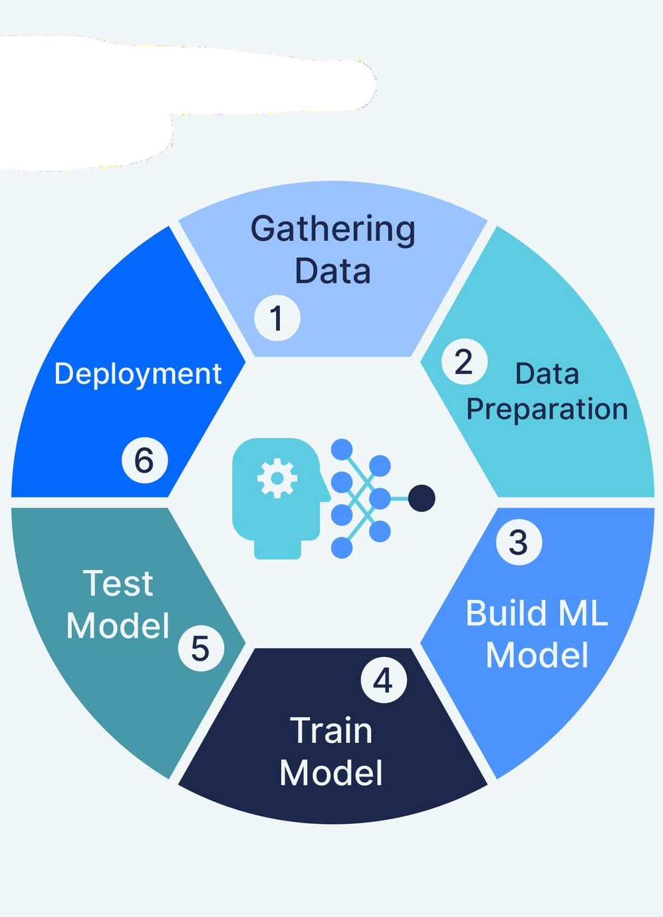
MODEL BUILDING
A Linear Regression model was selected to predict electricity consumption based on temperature, humidity, and appliance usage.
A Pipeline was created that combines preprocessing (StandardScaler) and the regression model into a single structured workflow.
The dataset was split into 80% training and 20% testing to
ensure proper model validation.
The model was trained on the processed data, learning the relationships between input features and electricity consumption.
After training, the model generated predictions and was evaluated using Mean Squared Error (MSE) and R² Score to measure accuracy.

Slide 8

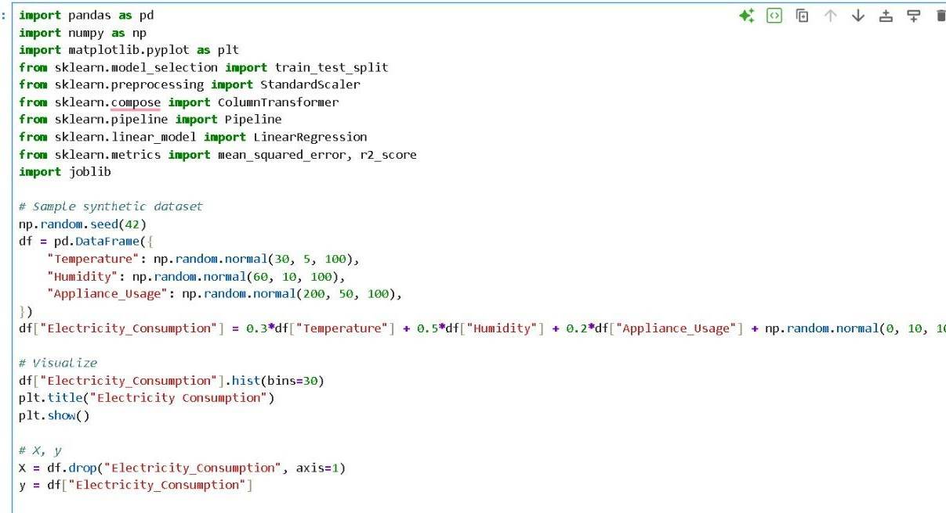

Slide 9
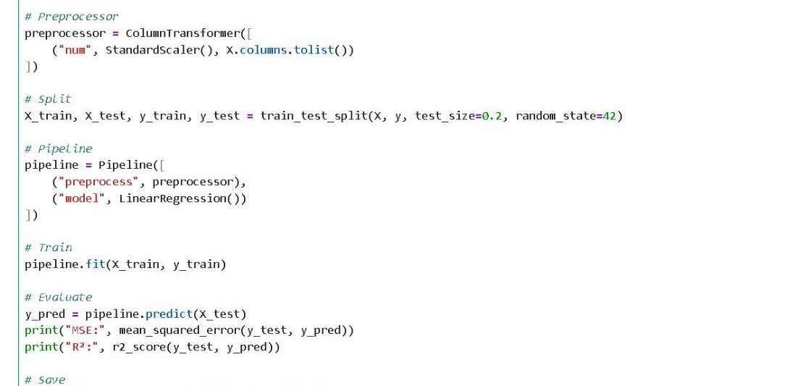

Slide 10

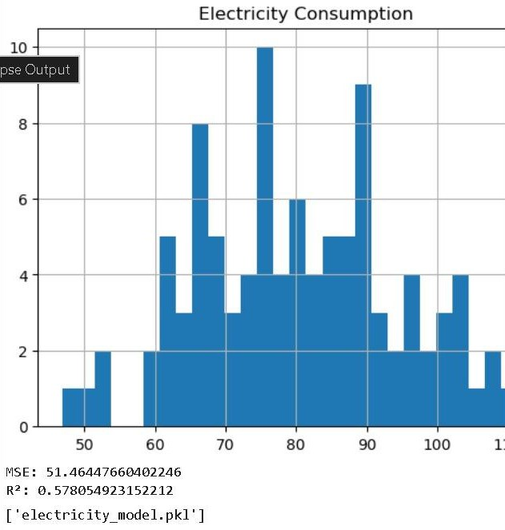
MODEL EVALUATION
The trained Linear Regression model was tested using unseen data (20% test split).
Mean Squared Error (MSE): 51.46
1. Indicates the average squared
actual
difference electricity
between predicted and
consumption values.
Lower MSE means better prediction accuracy.
R² Score: 0.578
Shows that the model explains 57.8% of the variation in electricity consumption.
This is a good result considering the dataset contains synthetic data with noise.
The evaluation confirms that the model can effectively learn patterns from Temperature, Humidity, and Appliance Usage to predict electricity consumption.

Slide 11

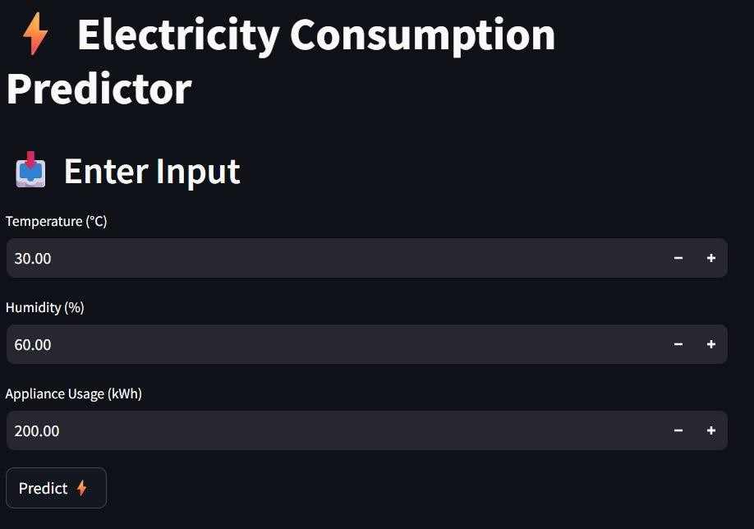
The model is deployed using Streamlit, a lightweight Python framework for building interactive web applications.
The app provides an easy-to-use interface where users can input Temperature, Humidity, and Appliance Usage to get a
predicted
electricity
consumption value.
Input fields are created using Streamlit components such as number_input for smooth user interaction.
The saved machine learning model (electricity_model.pkl) is loaded in the backend, and predictions are displayed instantly when the user clicks the Predict button.

Slide 12
APPLICATIONS
05
Home electricity
Smart meters
management
Industrial consumption planning
Renewable energy forecasting

Slide 13
CONCLUSION
05
In this project, we successfully built and deployed an electricity consumption predictor. By leveraging Linear Regression, we achieved a simple yet effective solution for forecasting electricity usage. The integration of a Streamlit interface makes the application interactive and user-friendly, allowing users to easily input data and obtain predictions.
This project can be further enhanced by incorporating real-world datasets and experimenting with more advanced machine learning models such as Random Forest and XGBoost to improve accuracy and performance.

Slide 14


THANK YOU
10
Presentation
ABby:hinav Sharma
Date:
November, 26 ,2025

